Slide 1
The Big Mountain Resort
Ticket Pricing Predictive Model
July 19th, 2021

Slide 2
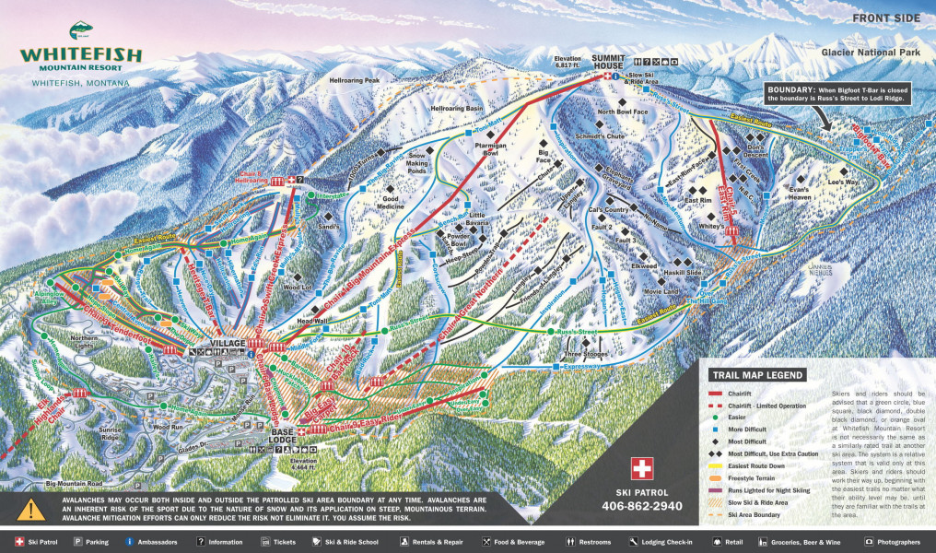
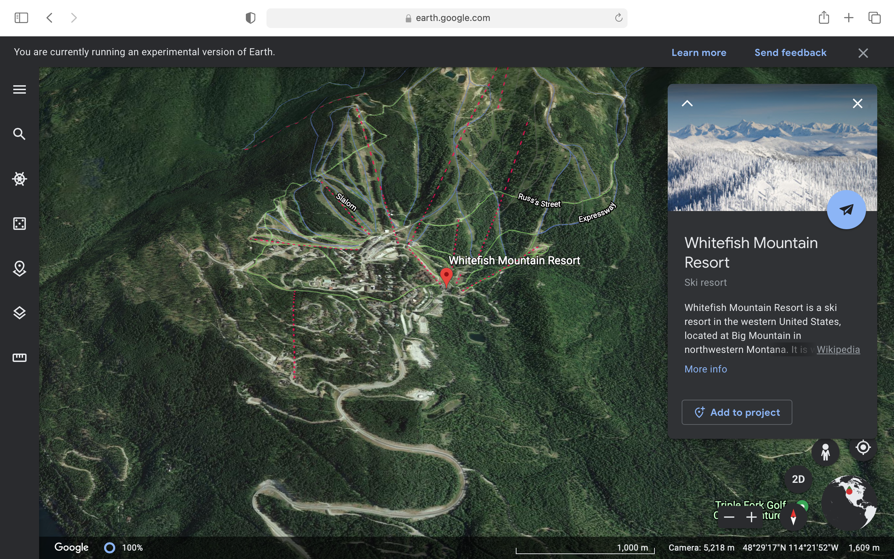
Big Mountain Resort (aka Whitefish Mountain Resort)
Problem Identification

Slide 3
Objectives

Slide 4
Recommendation and key findings

Slide 5
Modeling results and analysis

Slide 6
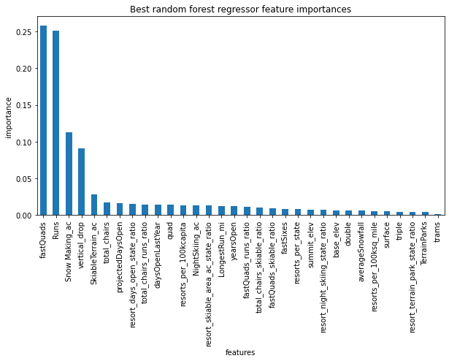
Prediction and scenario testing

Slide 7
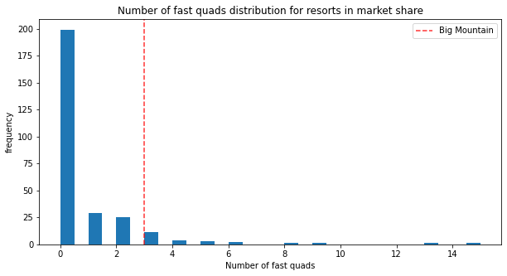
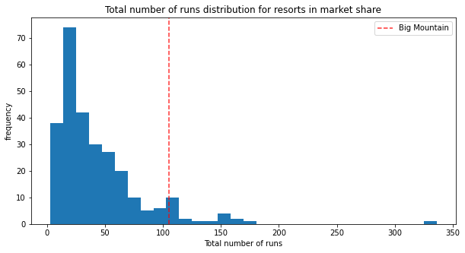
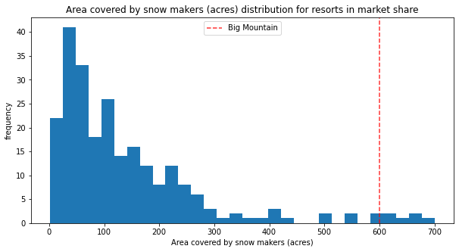
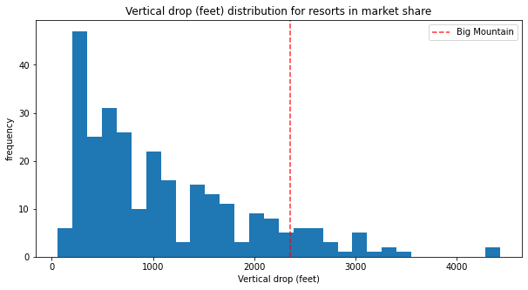
Big Mountain Resort Facilities vs The Competition

Slide 8
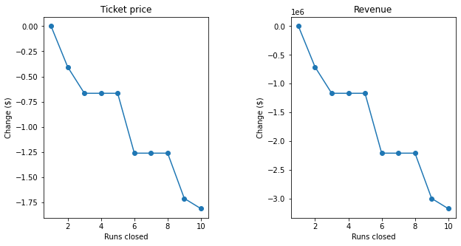
Scenario Testing

Slide 9
Scenario Testing cont.

Slide 10
Summary and conclusion

Slide 11
Further Work

